Slide 1
03/02/2022
Title: Operations with negative numbers
Aim:
Know, and be able to apply, the rules for multiplying and dividing integers.
Plan:
Daily review:
Addition and subtraction of integers.
Multiplication and division of integers.
Independent practice – mixed operations.

Slide 2
Daily review: Addition and subtraction of integers.
Addition and Subtraction: A number-line approach
To use the number line you need a , a
and a to move.
Double signs:
Adding a negative number is the same as .
Subtracting a negative number is the same as .
-3 + (-2) can be written as -3
-3 – (-2) can be written as -3
Notes:
Student worksheet 1

Slide 3
Daily review: Addition and subtraction of integers.
Addition and Subtraction: A number-line approach
To use the number line you need a starting point, a direction and a number of places to move.
Double signs:
Adding a negative number is the same as subtracting.
Subtracting a negative number is the same as adding.
-3 + (-2) can be written as -3 – 2

Slide 4
Independent practice:
1. -2 – (- 3)
=
=
-3 + (- 8)
=
=
4 – (- 7)
=
=
-8 + (-5)
=
=
5. -2 + (– 6) – (-2)
=
=
6. 3 – (- 3) + (-3) – (-3)
=
=
7. 43 + (– 52)
=
=
8. - 28 – (-25)
=
=
Notes:
Student worksheet 2

Slide 5
Independent practice:
1. -2 – (- 3)
= -2 + 3
= 1
-3 + (- 8)
= -3 – 8
= -11
4 – (- 7)
= 4 + 7
= 11
-8 + (-5)
= -8 – 5
= -13
5. -2 + (– 6) – (-2)
= -2 – 6 + 2
= -6
6. 3 – (- 3) + (-3) – (-3)
= 3 + 3 – 3 + 3
= 6
7. 43 + (– 52)
= 43 – 52
= - 9
8. - 28 – (-25)
= -28 + 25
= -3

Slide 6

Multiplication of integers:
Using patterns to develop understanding and create rules.
6 $×$ 3 =
6 $×$ 2 =
6 $×$ 1 =
6 $×$ 0 =
6 $×$ (-1) =
6 $×$ (-2) =
6 $×$ (-3) =
Multiplying a positive number by a negative number will always give a ___________ result.
Multiplying a negative number by a positive number will always give a ___________ result.
Notes:
Student worksheet 3 Discuss commutative property of multiplication

Slide 7
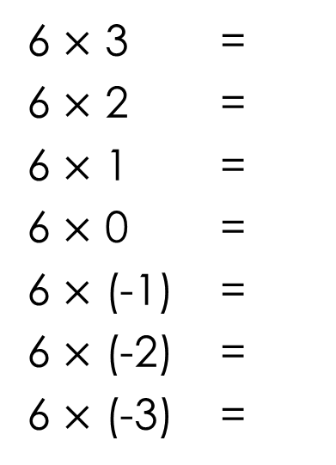
Multiplication of integers:
Using patterns to develop understanding and create rules.
6 $×$ 3 =
6 $×$ 2 =
6 $×$ 1 =
6 $×$ 0 =
6 $×$ (-1) =
6 $×$ (-2) =
6 $×$ (-3) =
18
12
6
0
-6
-12
-18
Multiplying a positive number by a negative number will always give a result.
negative
Multiplying a negative number by a positive number will always give a result.
negative

Slide 8

Multiplication of integers:
Using patterns to develop understanding and create rules.
-6 $×$ 3 =
-6 $×$ 2 =
-6 $×$ 1 =
-6 $×$ 0 =
-6 $×$ (-1) =
-6 $×$ (-2) =
-6 $×$ (-3) =
Multiplying a negative number by a negative number will always give a ___________ result.
Notes:
Student worksheet 4

Slide 9
Multiplication of integers:
Using patterns to develop understanding and create rules.
-18
-12
-6
0
6
12
18
-6 $×$ 3 =
-6 $×$ 2 =
-6 $×$ 1 =
-6 $×$ 0 =
-6 $×$ (-1) =
-6 $×$ (-2) =
-6 $×$ (-3) =
Multiplying a negative number by a negative number will always give a ___________ result.
positive

Slide 10
Choral reading
A negative multiplied to a positive will always give a negative result.
A negative multiplied to a negative will always give a positive result.
A positive multiplied to a negative will always give a negative result.

Slide 11
In pairs – label person A and person B
A states 3 sentences to B then B to A
A negative multiplied to a positive will always give a negative result.
A negative multiplied to a negative will always give a positive result.
A positive multiplied to a negative will always give a negative result.
Notes:
Finish with random draws before displaying answers.

Slide 12

Independent practice: exercise books.
-2 $×$ 6
-3 $×$ (-8)
4 $×$ (-7)
-8 $×$ (-5)
-5 $×$ 8
-2 $×$ 3 $×$ (-1)
5 $×$ (-2) $×$ (-3)
-5 $×$ (-2) $×$ 3
24 $×$ (-32)
-3.2 $×$ (-4.6)
Check answers with your calculator.

Slide 13
Mixed operations.
Answers in exercise books,
with correct setting out.
Title and question reference in exercise book required.
Notes:
Discuss how multiplication and division are the same.

